Slide 1
Lecture 18: Multiclass Logistic Regression

Slide 2
Lecture Outline: Multiclass Classification
Multinomial Logistic Regression
OvR Logistic Regression
k-NN for multiclass

Slide 3
Logistic Regression for predicting 3+ Classes
There are several extensions to standard logistic regression when the response variable Y has more than 2 categories. The two most common are:
ordinal logistic regression
multinomial logistic regression.
Ordinal logistic regression is used when the categories have a specific hierarchy (like class year: Freshman, Sophomore, Junior, Senior; or a 7-point rating scale from strongly disagree to strongly agree).
Multinomial logistic regression is used when the categories have no inherent order (like eye color: blue, green, brown, hazel, et...).

Slide 4
Multinomial Logistic Regression

Slide 5
Multinomial Logistic Regression
There are two common approaches to estimating a nominal (not-ordinal) categorical variable that has more than 2 classes. The first approach sets one of the categories in the response variable as the reference group, and then fits separate logistic regression models to predict the other cases based off of the reference group. For example we could attempt to predict a student’s concentration:
from predictors X₁ number of psets per week, X₂ how much time playing video games per week, etc.

Slide 6
Multinomial Logistic Regression (cont.)
We could select the y = 3 case as the reference group (other concentration), and then fit two separate models: a model to predict y = 1 (CS) from y = 3 (others) and a separate model to predict y = 2 (Stat) from y = 3 (others).
Ignoring interactions, how many parameters would need to be estimated?
How could these models be used to estimate the probability of an individual falling in each concentration?

Slide 7
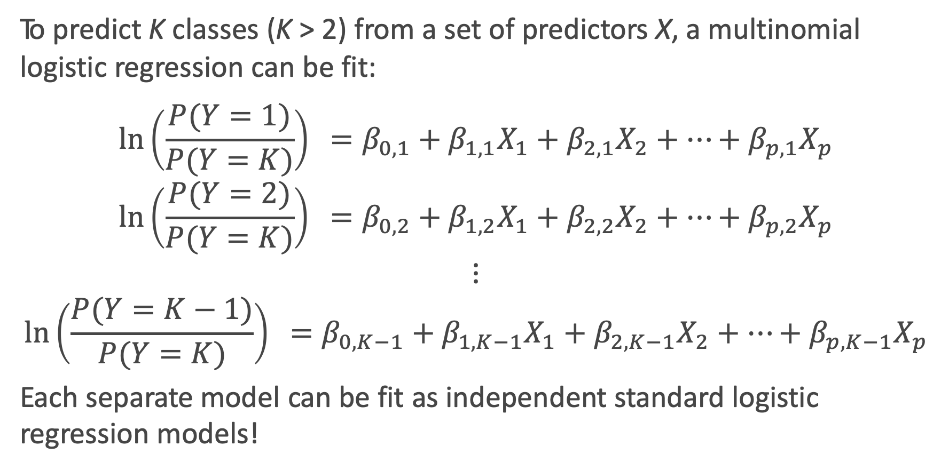
Multinomial Logistic Regression: the model
To predict K classes (K > 2) from a set of predictors X, a multinomial logistic regression can be fit:
$$\ln\left(\frac{P(Y=1)}{P(Y=K)}\right) =β_{0,1}+β_{1,1}X_{1}+β_{2,1}X_{2}+…+β_{p,1}X_{p}$$
$$\ln\left(\frac{P(Y=2)}{P(Y=K)}\right) =β_{0,2}+β_{1,2}X_{1}+β_{2,2}X_{2}+…+β_{p,2}X_{p}$$
$$⋮$$
$$\ln\left(\frac{P(Y=K−1)}{P(Y=K)}\right) =β_{0,K−1}+β_{1,K−1}X_{1}+β_{2,K−1}X_{2}+…+β_{p,K−1}X_{p}$$
Each separate model can be fit as independent standard logistic regression models!

Slide 8
Multinomial Logistic Regression in sklearn
But wait Kevin, I thought you said we only fit K – 1 logistic regression models!?!? Why are there K intercepts and K sets of coefficients????

Slide 9
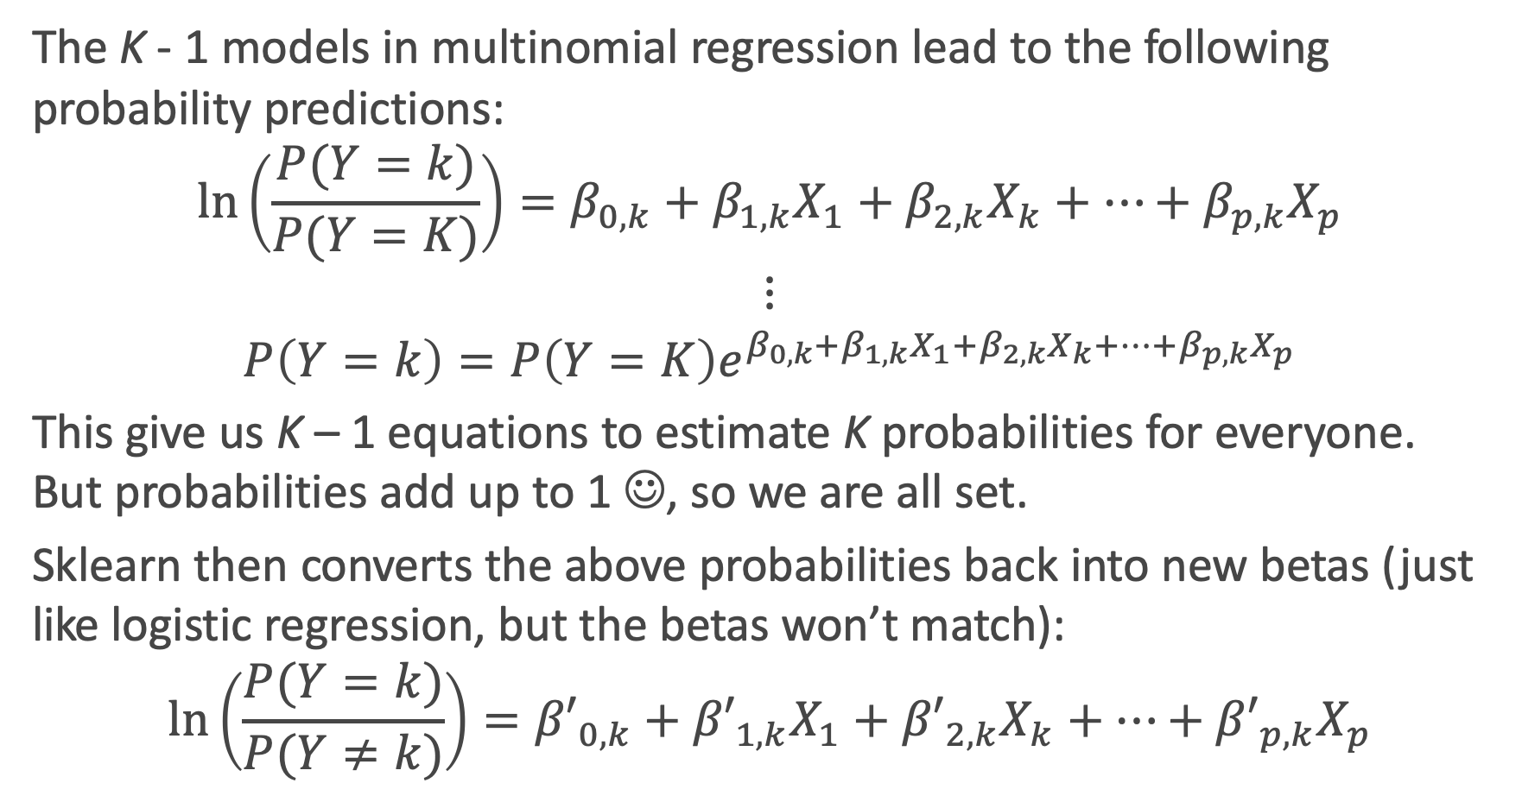
What is sklearn doing?
The K - 1 models in multinomial regression lead to the following probability predictions:
$$\ln\left(\frac{P(Y=k)}{P(Y=K)}\right){=β_{0,k}+β_{1,k}X_{1}+β_{2,k}X_{k}+…+β_{p,k}X_{p}}$$
$$⋮$$
$$P\left(Y=k\right)=P\left(Y=K\right)e^{β_{0,k}+β_{1,k}X_{1}+β_{2,k}X_{k}+…+β_{p,k}X_{p}}$$
This give us K – 1 equations to estimate K probabilities for everyone. But probabilities add up to 1 ☺, so we are all set.
Sklearn then converts the above probabilities back into new betas (just like logistic regression, but the betas won’t match):
$$\ln\left(\frac{P(Y=k)}{P(Y≠k)}\right){={β′}_{0,k}+{β′}_{1,k}X_{1}+{β′}_{2,k}X_{k}+…+{β′}_{p,k}X_{p}}$$

Slide 10
One vs. Rest (OvR) Logistic Regression

Slide 11
One vs. Rest (OvR) Logistic Regression
An alternative multiclass logistic regression model in sklearn is called the ’One vs. Rest’ approach, which is our second method.
If there are 3 classes, then 3 separate logistic regressions are fit, where the probability of each category is predicted over the rest of the categories combined. So for the concentration example, 3 models would be fit:
a first model would be fit to predict CS from (Stat and Others) combined.
a second model would be fit to predict Stat from (CS and Others) combined.
a third model would be fit to predict Others from (CS and Stat) combined.
An example to predict play call from the NFL data follows...

Slide 12
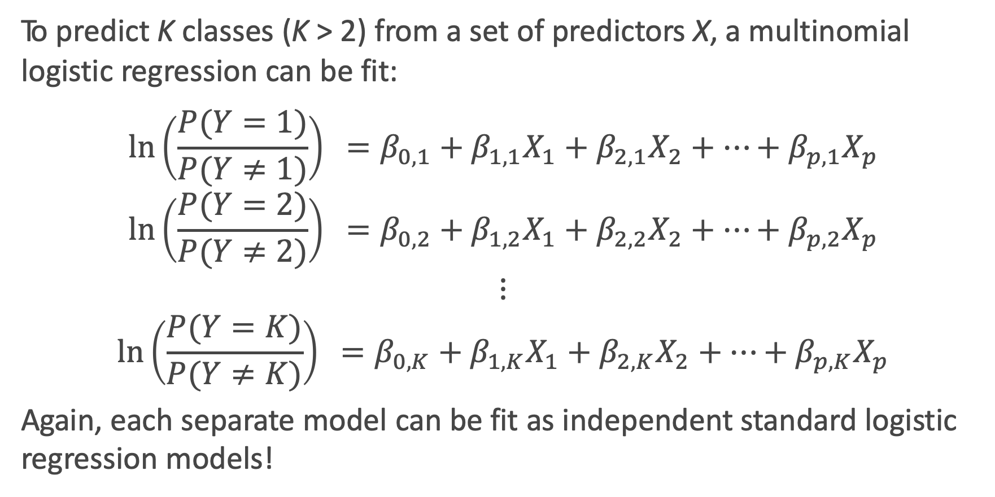
One vs. Rest (OvR) Logistic Regression: the model
To predict K classes (K > 2) from a set of predictors X, a multinomial logistic regression can be fit:
$$\ln\left(\frac{P(Y=1)}{P(Y≠1)}\right) =β_{0,1}+β_{1,1}X_{1}+β_{2,1}X_{2}+…+β_{p,1}X_{p}$$
$$\ln\left(\frac{P(Y=2)}{P(Y≠2)}\right) =β_{0,2}+β_{1,2}X_{1}+β_{2,2}X_{2}+…+β_{p,2}X_{p}$$
$$⋮$$
$$\ln\left(\frac{P(Y=K)}{P(Y≠K)}\right) =β_{0,K}+β_{1,K}X_{1}+β_{2,K}X_{2}+…+β_{p,K}X_{p}$$
Again, each separate model can be fit as independent standard logistic regression models!

Slide 13
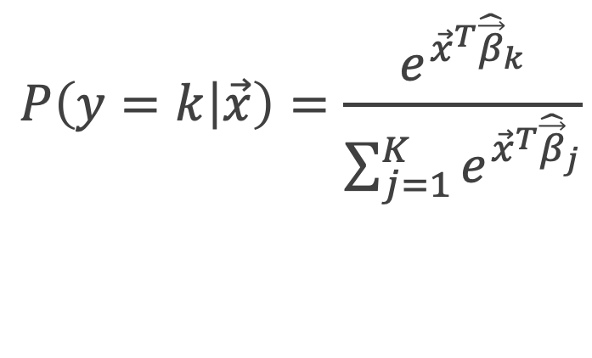
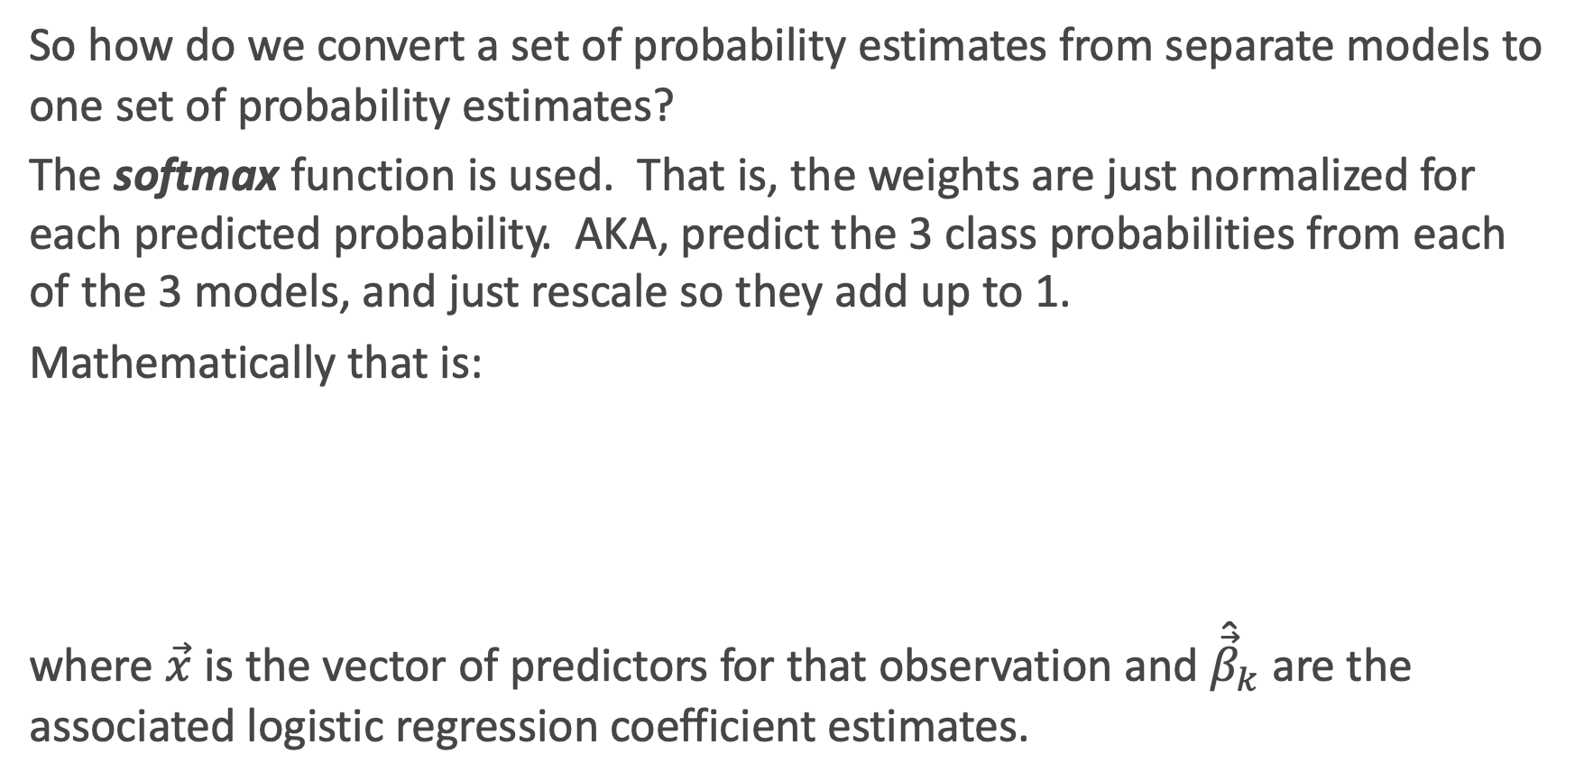
Softmax
So how do we convert a set of probability estimates from separate models to one set of probability estimates?
The softmax function is used. That is, the weights are just normalized for each predicted probability. AKA, predict the 3 class probabilities from each of the 3 models, and just rescale so they add up to 1.
Mathematically that is:
where $\vec{x}$ is the vector of predictors for that observation and ${\hat{\vec{β}}}_{k}$are the associated logistic regression coefficient estimates.
$$P\left(y=k | \vec{x}\right)=\frac{e^{{\vec{x}}^{T}{\hat{\vec{β}}}_{k}}}{\sum_{j=1}^{K}{e^{{\vec{x}}^{T}{\hat{\vec{β}}}_{j}}}}$$

Slide 14
OVR Logistic Regression in Python
Phew! This one is as expected ☺

Slide 15
Predicting Type of Play in the NFL

Slide 16
Classification for more than 2 Categories
When there are more than 2 categories in the response variable, then there is no guarantee that P(Y = k) ≥ 0.5 for any one category. So any classifier based on logistic regression (or other classification model) will instead have to select the group with the largest estimated probability.
The classification boundaries are then much more difficult to determine mathematically. We will not get into the algorithm for determining these in this class, but we can rely on predict and predict_proba!

Slide 17
Prediction using Multiclass Logistic Regression

Slide 18
Classification Boundary for 3+ Classes in sklearn

Slide 19
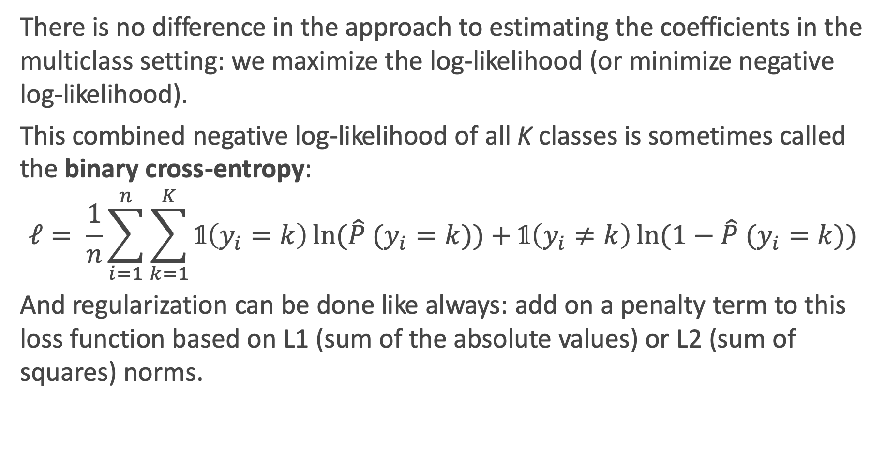
Estimation and Regularization in multiclass settings
There is no difference in the approach to estimating the coefficients in the multiclass setting: we maximize the log-likelihood (or minimize negative log-likelihood).
This combined negative log-likelihood of all K classes is sometimes called the binary cross-entropy:
$$ℓ= \frac{1}{n}\sum_{i=1}^{n}{\sum_{k=1}^{K}{𝟙\left(y_{i}=k\right)\ln{(\hat{P} (y_{i}=k))}+𝟙\left(y_{i}≠k\right)\ln{(1−\hat{P} (y_{i}=k))}}}$$
And regularization can be done like always: add on a penalty term to this loss function based on L1 (sum of the absolute values) or L2 (sum of squares) norms.

Slide 20
Multiclass k-NN

Slide 21
k-NN for 3+ Classes
Extending the k-NN classification model to 3+ classes is much simpler!
Remember, k-NN is done in two steps:
Find you k neighbors: this is still done in the exact same way
be careful of the scaling of your predictors!
Predict based on your neighborhood:
Predicting probabilities: just use the observed proportions
Predicting classes: plurality wins!

Slide 22
k-NN for 3+ Classes: NFL Data

Slide 23
Exercise Time! Ex. 1 (graded): Basic multiclass Logistic Regression and k-NN in sklearn (15+ min) Ex. 2 (not graded): A little more thinking and understanding (30+ min)

